Slide 1
Issue
Lack of communication opportunity with people who are hard to meet or don't talk much Popular SNSs are hard to talk due to public or to start conversation with who you are losing touch
Action
Provide 1 on 1 communication opportunities and topics by our proposal services
Target User
Students who live away from home Parents who live away from their children because of their works
Dev env
Java, HTML, CSS, PostgreSQL, Github, Docker, Watson API, Twitter4J, Bootstrap, Spring boot
Members Role
Front-end : Masahito Imai Back-end : Yuta Takayama, Tsukasa Nakamura, Naoto Nishida

Slide 2
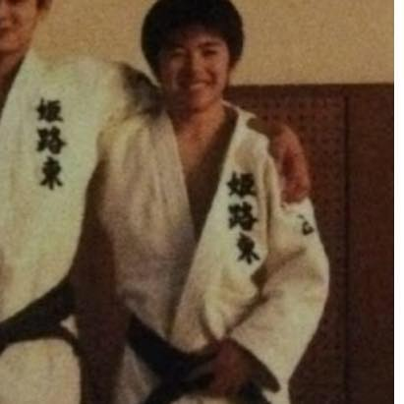
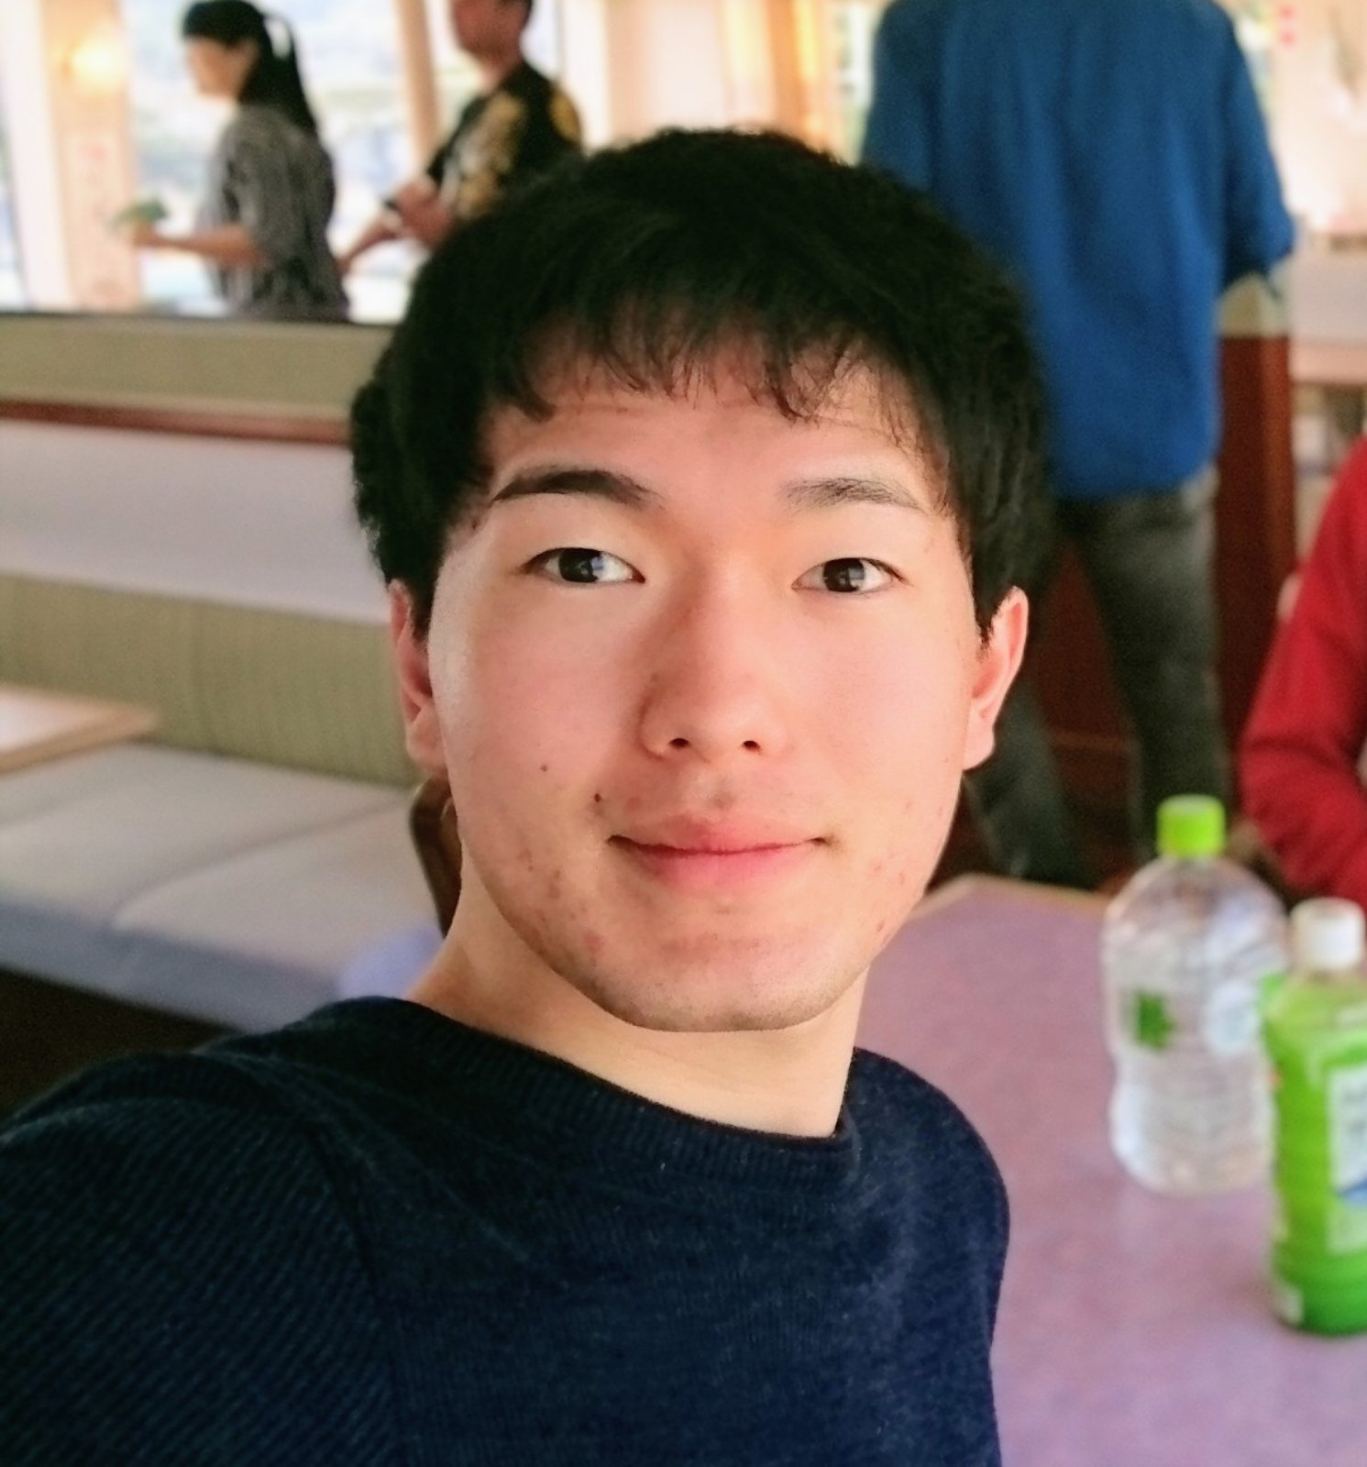


Team 緑の爪(Midori-no-tsume)
Naoto Nishida, Masahito Imai,
Yuta Takayama, Tsukasa Nakamura
Mentors : Terada Atsushi-san, Wakita Kenya-san
Notes:
Hello everyone
We gonna show you guys our supreme innovative application
メンバー紹介~~
Lets get started

Slide 3


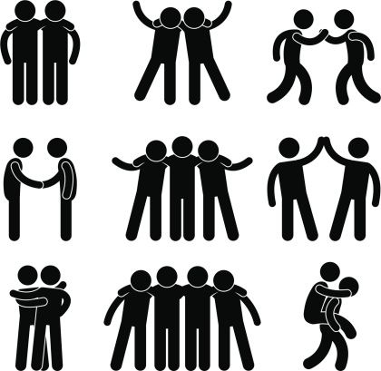

Issue
Lack of communication opportunity
demands for a service you can catch up with people in distance, on a daily basis.
Notes:
First, Im gonna introduce some background issues here
Haven’t you bumped into such problems?
COVID-19 made people more isolated, because you cannot meet your friends of your university or members of your lab in person, and it also prevent you from getting back to your hometown to see your old friends, and parents.
Of course, you can talk with them online, like with a chat app, but as you know, you cannot easily catch up with every one of them.
And so are parents, according to our survey to our acquaintance and parents, more than half of them agreed with the idea that they want to know children’s recent news without bothering them, like «how are you» messages everyday like a broken record.

Slide 4
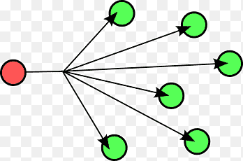




Issue on SNS
1-to-many : conversation exposed to public
Ex)
1-to-1 : hard to start convesations without some topics
Ex)
Notes:
In addition to that, existing SNS have several problems,
First, about 1 to many type of SNS,
Which means broadcasting type,
your conversation is exposed to public, so you cannot start conversation which you want to keep secret.
Second, in 1 to 1 type of SNS, you barely start a conversation with your remote friends unless you have some topic to talk about.

Slide 5
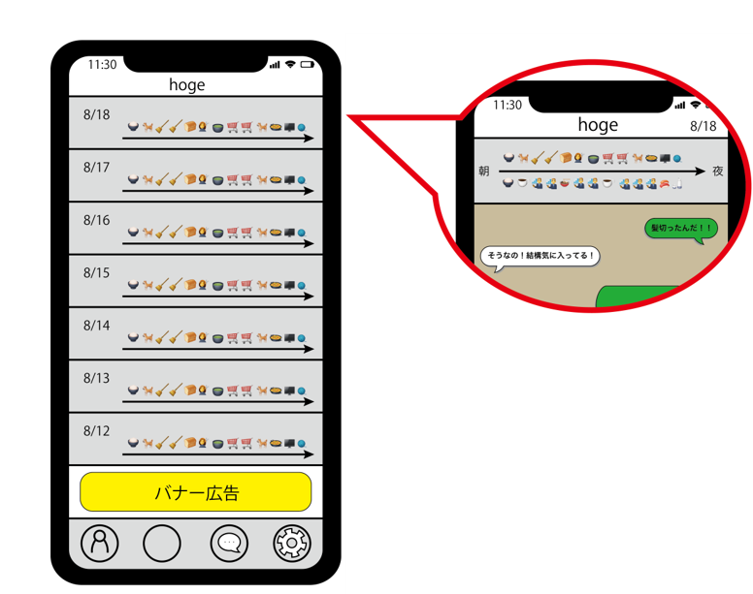
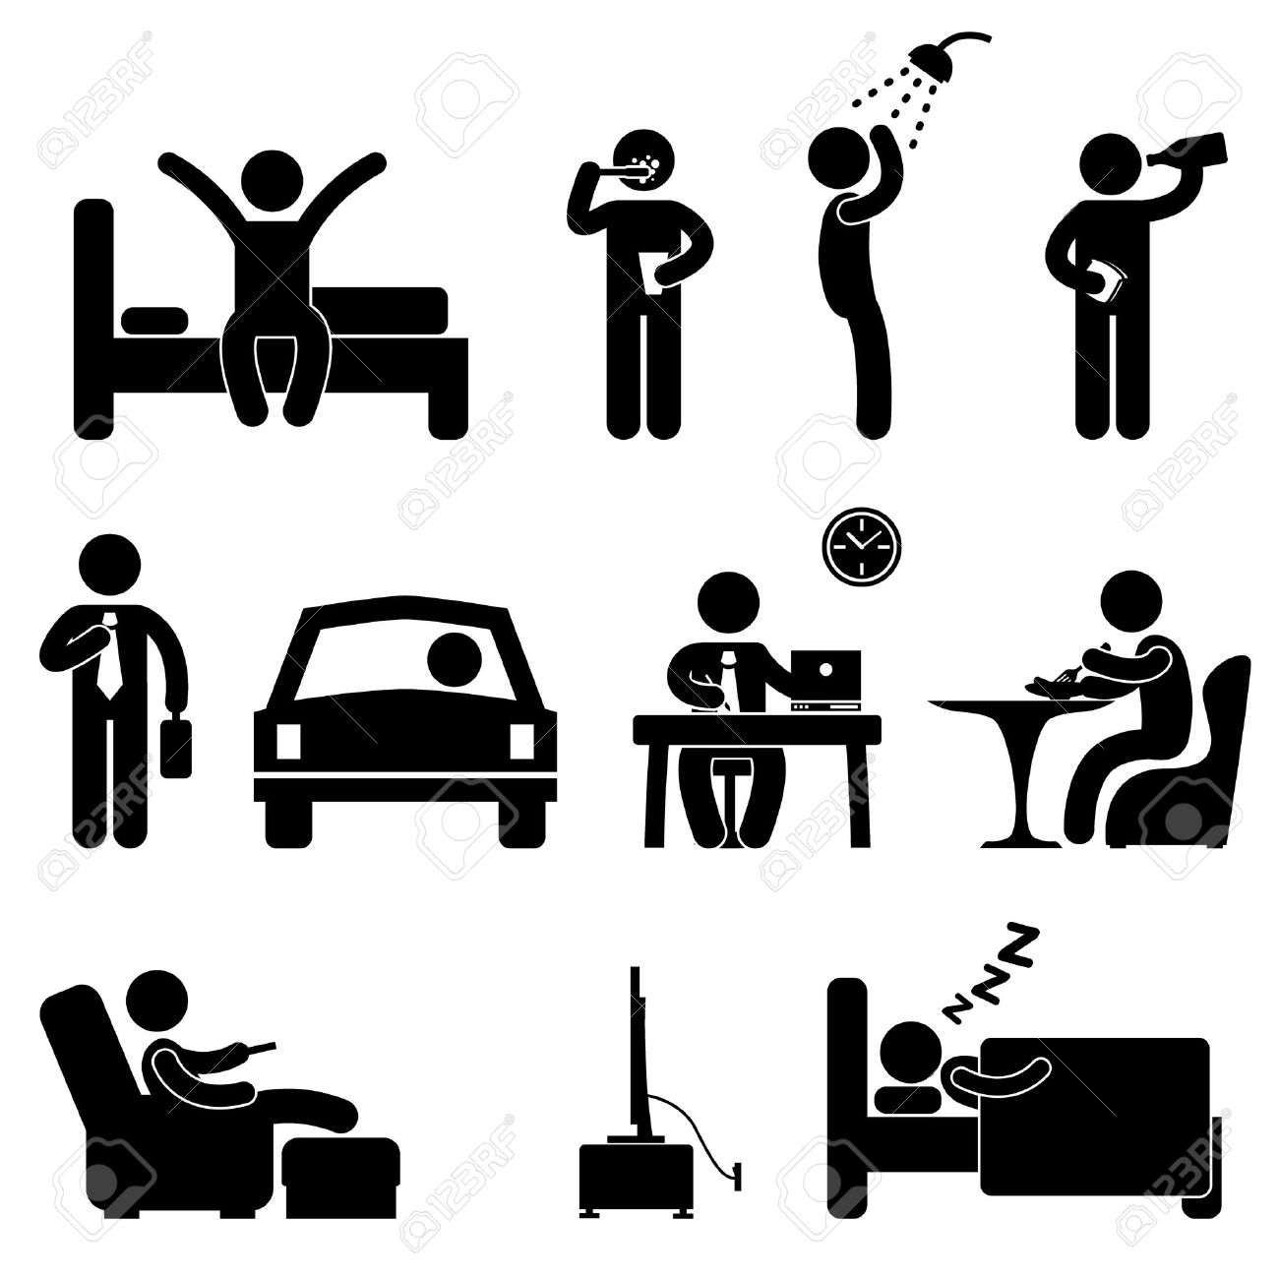
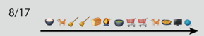
Solutions
App enabling you to keep in touch with your precious people
EmoLog
Notes:
Against these problems, we chose to provide an application software enabling you to keep in touch with your friends, family and children.
To provide details, we use the summary of the day represented with successive emoji, as a topic to talk about. This is called emolog.
Why? Because emoji is vague, abstract and you have to ask your friends what they mean in order to fill your curiosity.
Thus, it leads to a good conversation.
Technically speaking, extracting your lifelog automatically and process them into emolog, and post it on the service on occasion so you can talk with friends with chat function in it.

Slide 6
Target user
parents and children whose children are living on their own as students.
Close friends who has moved away from where he lives
Notes:
Our service's main targets are parents and children whose children are living on their own as students.
Among them, the majority of parents want to know as much as possible what their students are doing and where they are. However, they fear that frequent parental contact will frustrate the child . Therefore, parents tend to be hesitant to contact their children. This is a fact that was obtained by surveying the parents of the team members.
On the other hand, children find it troublesome to contact their parents, but they want an opportunity to communicate with them.
Next, let me show you a demo
Our service is able to notify parents of an abstract lifelog that they may want to contact and encourage communication. For example, "I went on a trip", "I did sports", etc.
We can also use it to share information with each other, such as friends who we don't see often due to graduation.
Changing the frequency of EmoLog notifications according to the recipient can trigger communication according to the recipient

Slide 7

Concept Video
Notes:
This video explains the service and its use case.
Our service tracks social networking sites such as Twitter.
A tweet has text and image information.
The EmoLog service uses IBM's Watson API to convert these into keywords.
For example, in this tweet, it's "Sun" and "Mountain".
This keyword is used to convert to a pictogram.
Retrieves all tweets during the specified period.
Performs keyword and pictogram conversion and gets multiple pictograms.
These are arranged in chronological order in Emolog.
Translated with www.DeepL.com/Translator (free version)

Slide 8
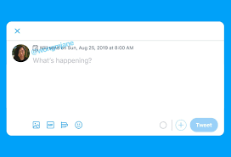


Product Outline
Posted lifelog of the day with emoji ( = "EmoLog" )
Diary with illustrations
Comment on lifelog (1 on 1)
Conversation makes your abstract lifelog more in detail !

Slide 9

Originality 1
Emolog is an abstract message
The receiver wonders what the EmoLog means & asks the sender about the EmoLog → Conversations will start
Not all of your life is exposed to your friends
Our App sometimes may send wrong EmoLogs → The sender will explain what happened → conversation

Slide 10

Originality 2
Emolog is sent automatically
Many students don't contact their parents but parents want to know about their sons' or daughters' daily lives
Notes:
ありそうな質問
・なぜ多くの学生がペアレントに連絡を取らないのか

Slide 11
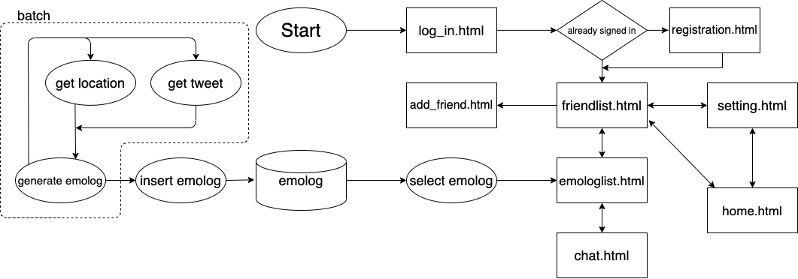
System flow chart

Slide 12
System flow chart

Slide 13








Technique
Programming Language
Tools & Frameworks
Notes:
Programming Language
Java, HTML, CSS, PostgreSQL
Tools & Frameworks
Github, Docker, Watson API, Twitter4J, Bootstrap, Spring boot

Slide 14
Achievement
Required functions
Generate EmoLog from SNS posts or location → Focus on SNS posts
Comments & Chat about EmoLog → Partially completed
Focused on improving fuctions really needed
Notes:
Then, I will introduce our Achievement.
There are 2 functions which our App required.
They are to generate EmoLog & to provide chat rooms.
We first planned to generate EmoLog from SNS posts or location.
But we came to focus on SNS posts finally.
And we completed comment & chat functions partially.
Overall, we focused on improving functions really needed.

Slide 15


Attentions in development
For group development
Github and Docker → Unify development environment
Share knowledge with each other → The skills of each members improved
For online development
Screen sharing
Communicate actively
Notes:
Next, I will explain what we cared on our development.
First, to develop smoothly as a group,
we utilized Github & Docker.
Thanks to them,
we could use libraries or frameworks of same versions.
And, we shared our knowledge with each other.
So the progress was delayed a little
but the skills of each members improved
Second, to develop smoothly online,
we utilized screen sharing & communicated actively.
So we could share our development troubles
or our daily incidents.

Slide 16
Members main role
Create DB table : Yuta
Communicate with Twitter API :
Communicate with Watson API :
Set up MVC templates :
Generate EmoLogs from extracted keyword :
Dummy data for test :
Graphic design :
Make Model to connect Frontend & Backend :

Slide 17
Members role
Development Environment
Generating Emologs
Naoto
Masahito
Connect Frontend & Backend
Graphic Design
Yuta
Tsukasa
Notes:
Next, I will explain members role.
First, to set up development environment,
Yuta-kun suggested Postgres, Docker and so on.
Second, members to generate Emologs are
Naoto-kun, Yuta-kun and me.
We extracted keywords from Twitter and convert them to EmoLog.
Third, Naoto-kun & Yuta-kun developed models or batch systems
to transfer data from backend to frontend.
Finally, Masahito-kun designed our App graphic
and Naoto-kun helped him.

Slide 18
Future update
Generate EmoLog from location
Register your friends
Notification of EmoLog arrival
Config（notification frequency，closeness，relation）
Notes:
Finally, I will introduce our future update.
First, to make EmoLogs more various,
we will utilize location to generate EmoLog.
Second, to make it easy to communicate with others,
we will add friend registration or notification.
Finally, to make our App more user-friendly,
we will add some configurations.

Slide 19


Presented by 緑の爪
Notes:
As a closing,
we provided the EmoLog service to connect people online .
That's all, thank you for listening.

Slide 21
デモ動画
Twitterからワード抽出して解析し絵文字にする処理の動画
操作部分
Friendlist.html ページにアクセス
Friendをクリックしてemologlist.html ページへアクセス
Emologをクリックしてchat.htmlページへアクセス

